Slide 1
Factorial Experiment Design on Key Factors Affecting BMI
Zichen Gong
1005682469

Slide 2
Materials and Methods

Slide 3
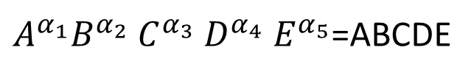
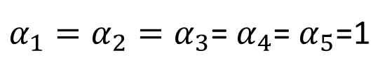
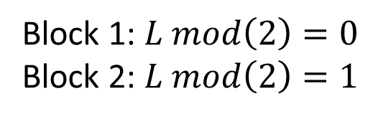
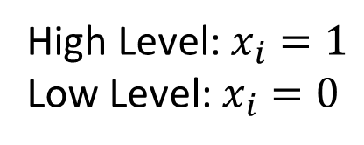
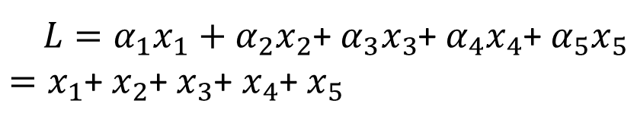
Experimental Design and Data
$α_{1}=α_{2}=α_{3}$= $α_{4}$= $α_{5}$=1
Factor | Column Name
A | Kidney Disease (Yes/No)
B | Smoking (Yes/No)
C | Alcohol Drinking (Yes/No)
D | Physical Activity (Yes/No)
E | Sleep Time (Numerical)
$A^{α_{1}}B^{α_{2}}$ $C^{α_{3}}$ $D^{α_{4}}$ $E^{α_{5}}$=ABCDE
$L=α_{1}x_{1}+α_{2}x_{2}$+ $α_{3}x_{3}$+ $α_{4}x_{4}$+ $α_{5}x_{5}$
$=x_{1}$+ $x_{2}$+ $x_{3}$+ $x_{4}$+ $x_{5}$
High Level: $x_{i}=1$
Low Level: $x_{i}=0$
Block 1: $L mod\left(2\right)=0$
Block 2: $L mod\left(2\right)=1$

Slide 4
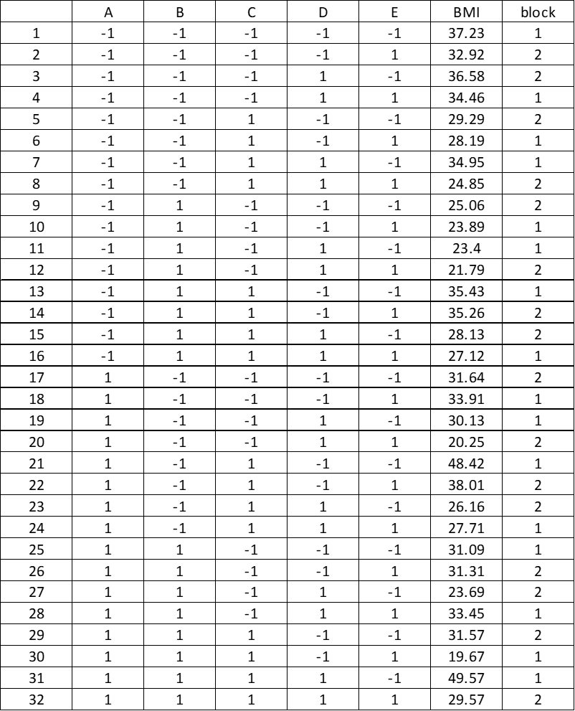
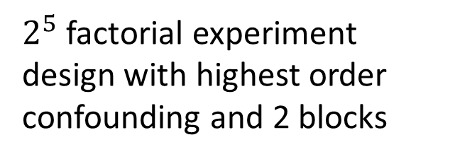
$2^{5}$ factorial experiment design with highest order confounding and 2 blocks

Slide 5
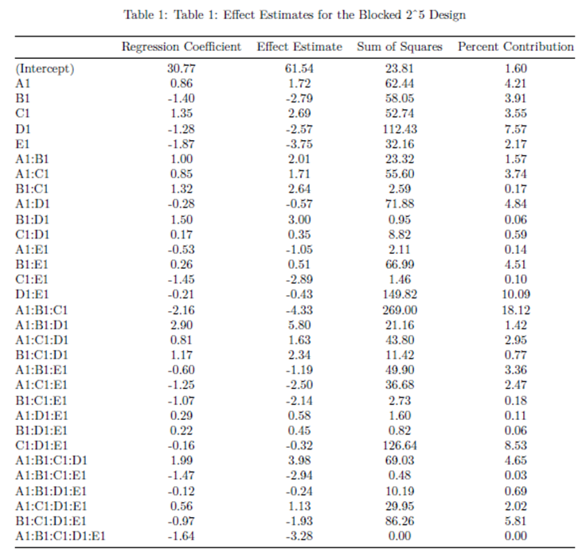
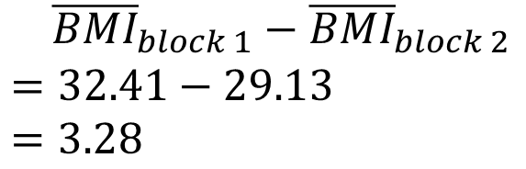
Statistical Analysis
${\overline{BMI}}_{block 1}−{\overline{BMI}}_{block 2}$
$$=32.41−29.13$$
$$=3.28$$

Slide 6
Results and Discussion

Slide 7
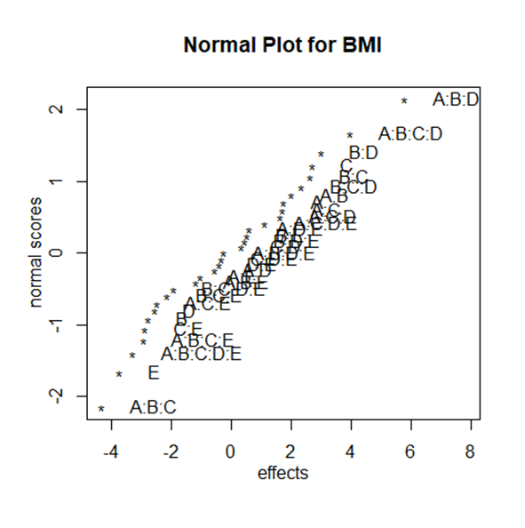
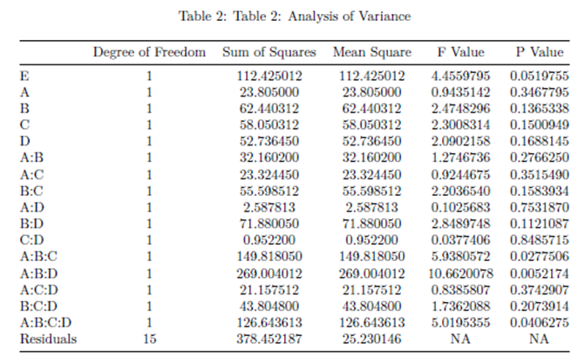

Slide 8
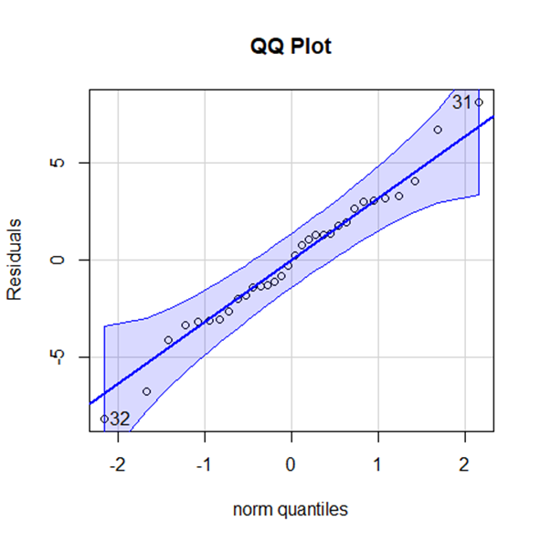
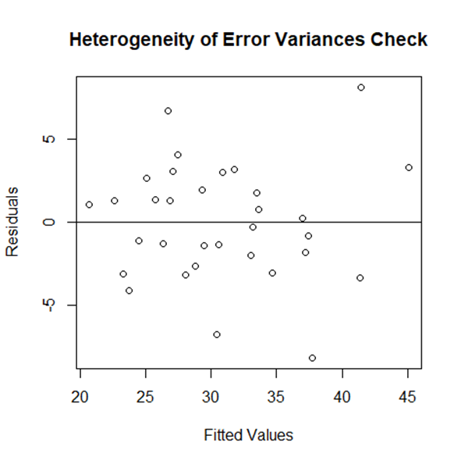

Slide 9
References
Are BMI charts different for men & women? (2019). Retrieved April 2, 2022, from https://gasparinutrition.com/blogs/fitness-facts/are-bmi-charts-different-for-men-women#:~:text=Recent%20studies%20have%20found%20that,21%20for%20women%20is%20healthy.
Hadley Wickham, Romain Fran鏾is, Lionel Henry and Kirill Müller (2022). dplyr: A Grammar of Data Manipulation. R package version 1.0.8. https://CRAN.R-project.org/package=dplyr (Last Accessed: April 3, 2022)
How Much Sleep Do I Need? (2017). Retrieved April 2, 2022, from https://www.cdc.gov/sleep/about_sleep/how_much_sleep.html
John Fox and Sanford Weisberg (2019). An {R} Companion to Applied Regression, Third Edition. Thousand Oaks CA: Sage. URL: https://socialsciences.mcmaster.ca/jfox/Books/Companion/ (Last Accessed: April 3, 2022)
Kaggle. (2022). Personal Key Indicators of Heart Disease [Data file]. Retrieved April 2, 2022, from https://www.kaggle.com/datasets/kamilpytlak/personal-key-indicators-of-heart-disease
R Core Team (2021). R: A language and environment for statistical computing. R Foundation for Statistical Computing, Vienna, Austria. URL https://www.R-project.org/ (Last Accessed: April 3, 2022)
Ulrike Gr”omping (2014). R Package FrF2 for Creating and Analyzing Fractional Factorial 2-Level Designs. Journal of Statistical Software, 56(1), 1-56. URL http://www.jstatsoft.org/v56/i01/ (Last Accessed: April 3, 2022)
Yihui Xie (2021). knitr: A General-Purpose Package for Dynamic Report Generation in R. R package version 1.37. (Last Accessed: April 3, 2022)

